Slide 1
Chapter Three
Gathering user requirements and Reusable technologies

Slide 2
What you Gather?
Functional requirement
Non-functional requirement
Use case
Actors

Slide 3
Functional Requirement
Something which is intended to be used or practical
Specify what a system do
What the system does, or.
Captures behavioral aspects
Backbone of the software requirement.
It depends on the complexity of the software system.
Define functions and functionality.

Slide 4
Examples of Functional Requirements:
Search option given to user to search from various invoices.
User should be able to mail any report to management.
Users can be divided into groups and groups can be given separate rights.

Slide 5
Cont…
Should comply business rules and administrative functions.
Software is developed keeping downward compatibility intact.

Slide 6
E.g.2: Library Management System (LMS)
What are functional requirements
Issue a book
Return a book
Membership facility
Reservation of books
Recording member’s data
Visiting book status

Slide 7
Non-Functional Requirements
Implicit expectations from the product
Expected features and specifically documented requirements, known as "quality attributes" of a system.
Also "qualities", "quality goals", "quality of service requirements", "constraints" and "non-behavioral requirements".

Slide 8
Cont…
Qualities—that is non-functional requirements—can be divided into two main categories:
Execution qualities, such as safety, security and usability, which are observable during operation (at run time).
Evolution qualities, such as testability, maintainability, extensibility and scalability, which are embodied in the static structure of the system.

Slide 9
Cont…
Non-functional requirement are more important than functional requirement
Why ?
Even if you miss one of FR the system can work properly but if you miss one of NFR the system is under problem .

Slide 10
Example: Library Management system
What are non-functional requirements
Security: Security levels (users, librarian administrative )
Usability: all members and users should effectively and easily use the system (user friendly).
Availability: the system gives service 8/24.
Scalability: the system should be enough to accommodate to the changes .
Reliability: the system should be enough to handle those problems
Efficiency: response time

Slide 11
Techniques (Methodology) of Data Gathering
Interviewing
Observation: (Ethnography) open and Close
Questioner
Manual(case study)
Workshop
Group discussion (Brain storming): technique where groups of people discuss a topic and say anything that comes into their minds about it.

Slide 12

Essential Use Case Modeling/Diagram
Use case: describes a sequence of actions that provide something of measurable value to an actor and is drawn as a horizontal ellipse.
Actor: is a person, organization, or external system that plays a role in one or more interactions with your system. Actors are drawn as stick figures.
An association exists whenever an actor is involved with an interaction described by a use case. It is indicated in use case diagrams by solid lines

Slide 13
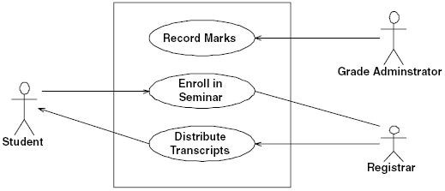
System boundary boxes (optional). indicates the scope of your system. It can be shown by drawing a rectangle around the use cases
A simple use case diagram for a university
Use case diagrams give you a very good overview of the requirements.

Slide 14
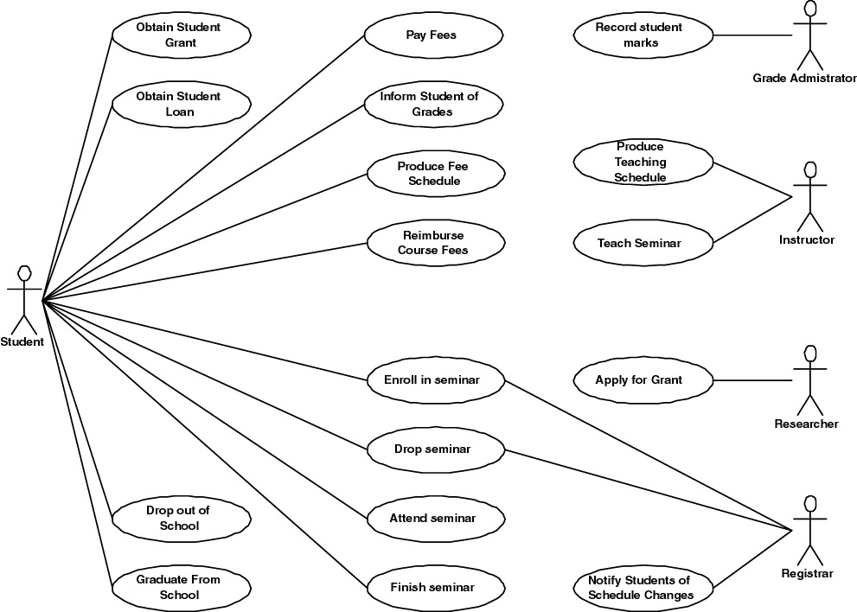
more complex use case diagram for the same university

Slide 15
You often draw a use case diagram while you are identifying use cases, actors, and the associations among them.
There are several interesting things to note about the use cases
These are just preliminary use cases: overtime you will change existing use cases, break them apart, combine them, introduce new use cases, and remove ones that do not make sense.
No time ordering is indicated between use cases. For example, you need to enroll in a seminar before you attend it, and you need to attend it before you pass it.
Customer actors are usually involved in many use cases: This is a normal phenomenon—after all; the main goal of most organizations is to provide services to their customers.

Slide 16
No arrowheads are on the associations: showing arrowheads on use case associations can be confusing for many people
Use cases should be functionally cohesive. A use case should encapsulate one service that provides value to an actor.
Use cases should describe something of business value. Use cases describe something of value to one or more actors.
Every actor is involved with at least one use case, and every use case is involved with at least one actor: If a use case does not provide service to an actor, then why have it? If an actor not involved in a use case exists, why model it?
Repetitive actions need not be expressed within a single use case: For example, a student will typically enroll in many seminars each semester. It is not necessary to express this fact within the use case, unless it makes sense to do so.

Slide 17
Identifying Actors
An actor represents anything or anyone that interacts with your system
People, external systems, and other organizations
To help indentify actors in your system, you should ask yourself the following questions:
Who is the main customer of your system?
Who obtains information from this system?
Who provides information to the system?
Who installs the system?
Who operates the system?
Who shuts down the system?
What other systems interact with this system?
Does anything happen automatically at a preset time?
Who will supply, use, or remove information from the system?
Where does the system get information?

Slide 18
Description of the Grade Administrator actor.
Name: Grade Administrator Description: A Grade Administrator will input, update, and finalize in the system the marks that students receive on assignments, tests, and exams. Deans, professors (tenured, assistant, and associate), and teaching assistants are all potential grade administrators

Slide 19
Identifying Use Cases
Identify potential services by asking your stakeholders the following questions from the point of view of the actors:
What are users in this role trying to accomplish?
To fulfill this role, what do users need to be able to do?
What are the main tasks of users in this role?

Slide 20
What information do users in this role need to examine, create, or change?
What do users in this role need to be informed of by the system?
What do users in this role need to inform the system about?
For example, from the point of view of the Student actor, you may discover that students
Enroll in, attend, drop, fail, and pass seminars.
Need a list of available seminars.
Need to determine basic information about a seminar, such as its description and its prerequisites.

Slide 21
Cont…
Obtain a copy of their transcript, their course schedules, and the fees due.
Pay fees, pay late charges, receive reimbursements for dropped and cancelled courses, receive grants, and receive student loans.
Graduate from school or drop out of it.
Need to be informed of changes in seminars, including room changes, time changes, and even cancellations.
Provide fundamental information about themselves such as their name, address, and phone number.

Slide 22
another way to identify use cases is to ask your stakeholders to brainstorm the various scenarios, often called usage/use case scenarios which your system may or may not support.
For example, the following would be considered use case scenarios for a university information system:
A student wants to enroll in a seminar, but the registrar informs him that he does not have the prerequisites for it.
A student wanted to enroll in a seminar that she does have the prerequisites for and seats are still available in the seminar.
A professor requests a seminar list for every course he teaches.
A researcher applies for a research grant, but only receives partial funding for her project.
A professor submits student marks to the system. These marks may be for exams, tests, or assignments.
A student wants to drop a seminar the day after the drop date.
A student requests a printed copy of his transcript, so he can include copies of it with his résumé.

Slide 23
You can take either approach, or combine the two, if you like, but the main goal is to end up with a lot of information regarding the behavioral aspects of your system.
The next step is to group these aspects, by similarity, into use cases. Remember that a use case provides a service of measurable value to an actor.
Use Case Discription
A use case is a sequence of actions that provide a measurable value to an actor.
An essential use case, sometimes called a business use case, is a simplified, abstract, generalized use case that captures the intentions of a user in a technology- and implementation-independent manner.
Business use case are somewhere in between essential and system use cases.

Slide 24
Preconditions describe the state or status the system must be in, prior to the execution of a use case. What must be true before the use case can execute?
Postconditions describe the state or status of the system as a result of the execution of the use case.

Slide 25
Enroll in Seminar as an essential use case
Enroll in Seminar ID: UC 1 Preconditions: The student is enrolled in the university. Post conditions: None
Actor(s) | Response
Student identifies himself | Verifies eligibility to enroll via BR1 Determine Eligibility to Enroll. Indicate available seminars
Choose seminar | Validate choice via BR2 Determine Student Eligibility to Enroll in a Seminar. Validate schedule fit via BR3 Validate Student Seminar Schedule Calculates fees via BR 4 Calculate Student Fees and BR5Calculate Taxes for Seminar. Summarize fees Request confirmation
Confirm enrollment | Enroll student in seminar Add fees to student bill Provide confirmation of enrollment

Slide 26
Use Case ID | UC-100
Use Case | Withdraw Funds
Actors | (P) Customer
Description | Customer logs in, selects withdraw funds, enters an amount and receives cash and receipt
Pre-conditions | Welcome screen is on
Flow of Events | Customer slides card in and out Machine prompts customer for password Customer enters password System authenticates customer System presents user with a choice menu Customer selects Withdraw Funds option System asks customer to select account Customer selects account System asks customer for amount to withdraw Customer enters amount System dispenses cash and prints receipt System logs customer out
Post-conditions | Welcome screen is back on
Alternative Flows | Customer may not be authenticated; customer may not have sufficient funds; machine may not have enough cash
Priority | High
Non-Functional Requirements | Cash dispensed within 10 seconds after amount is entered
Assumptions | Customer speaks English
Source | Bank’s Operational Procedures Manual
Base Use Case Example

Slide 27
Domain modeling with class responsibility collaborator (CRC) cards
A class responsibility collaborator model is a collection of standard index cards that have been divided into three sections.
A class represents a collection of similar objects,
A responsibility is something that a class knows or does, and
A collaborator is another class that a class interacts with to fulfill its responsibilities
cards can be identified by working closely with a project stakeholder who understood this part of the domain

Slide 28
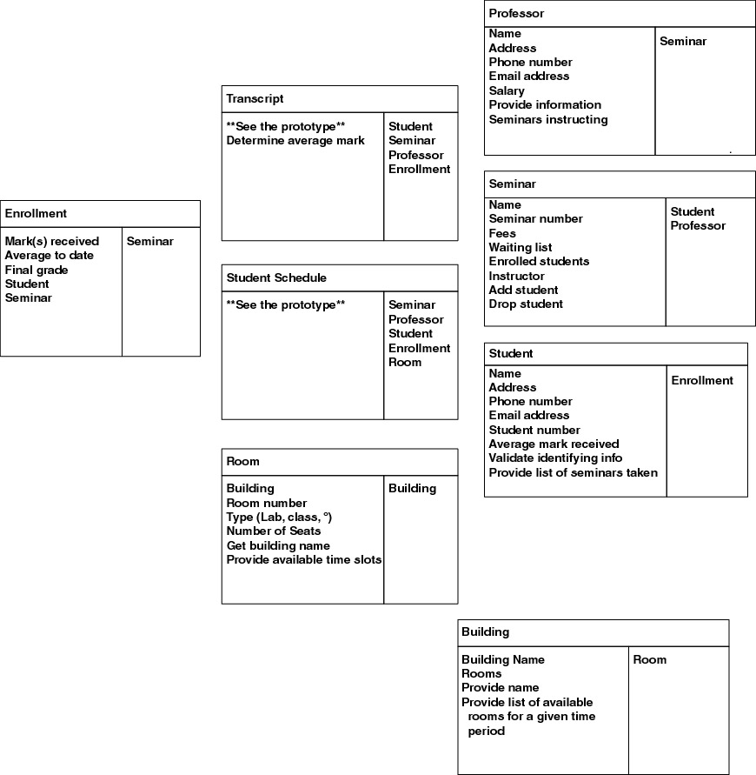
Some of the CRC cards for a university information system

Slide 29
Essential User Interface Prototyping
The UI is the portion of software with which a user directly interacts
It is the initial state—the beginning point—of the UI prototype for your system
represents the general ideas behind the UI, but not the exact details
Represents and models UI requirements in a technology-independent manner, evolved through analysis and design to result in the final user interface for your system
your prototyping tools are simple, including whiteboards, flip chart paper, and sticky notes
Essential UI modeling focus on your users and their usage of the system, not system features

Slide 30
Active Stakeholder Participation Is Crucial to provide requirements, to prioritize them, and to make decisions in a timely manner
A major UI element represents, potentially a screen, HTML page, or report.
A minor UI element represents, widgets such as user input fields, menu items, lists, or static text fields such as labels
Always remember that your project stakeholders are the official source of requirements, not developers
If you identify some new functionality that you think is required you need to convince your stakeholder that it is a good idea

Slide 31
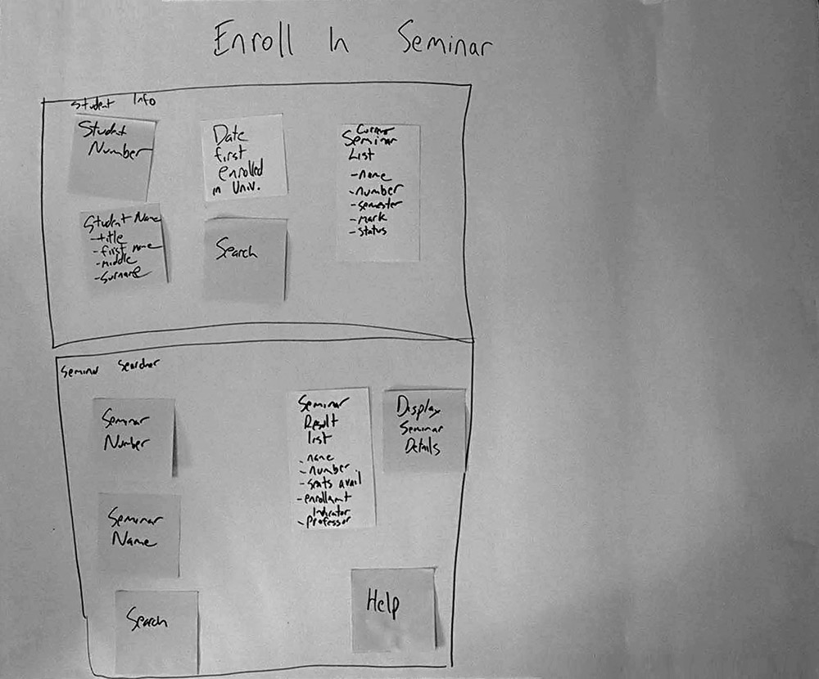
An essential UI prototype to enroll a student in a seminar

Slide 32
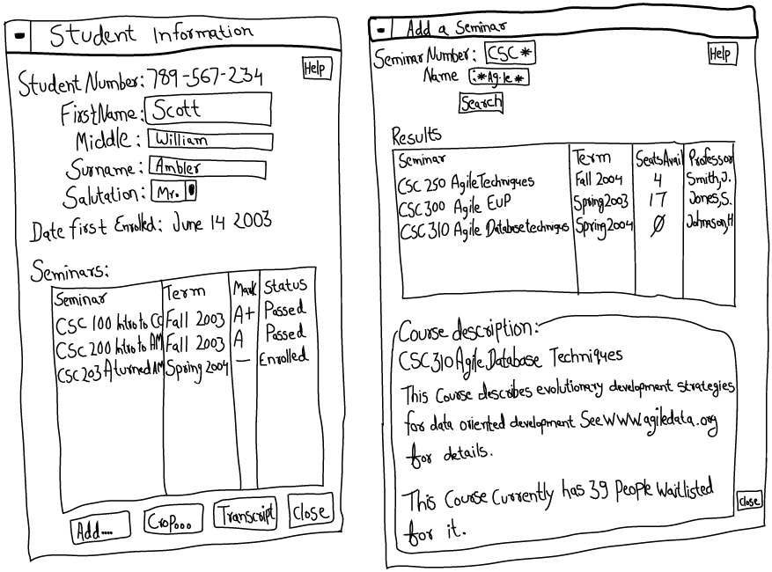
Revised essential UI prototype to enroll a student in a seminar

Slide 33
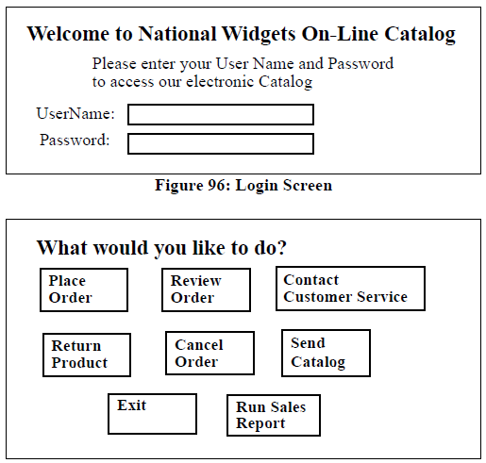

Slide 34
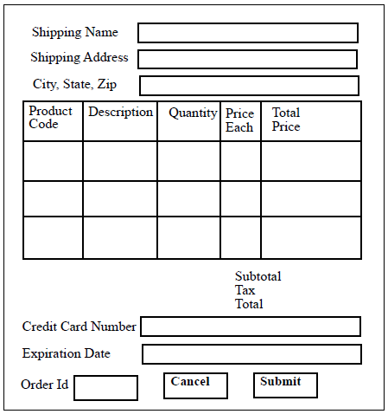
Cont..

Slide 35
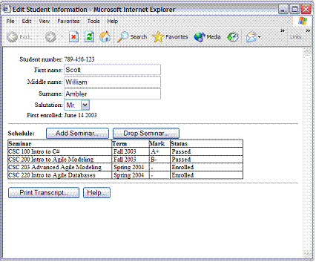

Slide 36
Developing a supplementary Specification
The goal of requirements engineering is not to create documentation; it is to convey ideas from project stakeholders to developers.
A supplementary specification is a document that contains requirements not contained directly in your use cases.
business rules,
technical requirements, and
Constraints
glossary
Business rules
Rules that influence the behavior of your business
focus on access control issues;
Some business rules focus on the policies of your organization

Slide 37
For example:
professors are allowed to input and modify the marks of the students taking the seminars they instruct, but not the marks of students in other seminars
how to convert a percentage mark (for example, 91 percent) that a student receives in a seminar into a letter grade (example, A-).
each business rule has a unique identifier. The convention is to use the format of BR#, but you are free to set your own numbering approach.
unique identifier enables you to refer easily to business rules in other development artifacts, such as class models and use cases

Slide 38
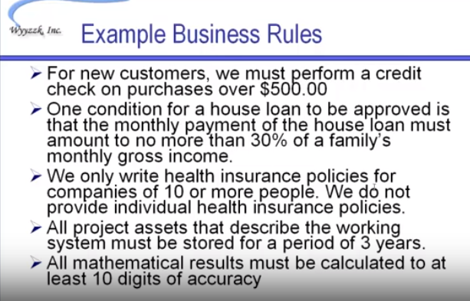

Slide 39
BR7 Tenured professors may administer student grades. BR8 Teaching assistants who have been granted authority by a tenured professor may administer student grades. BR9 Table to convert between numeric grades and letter grades. BR6 All master's degree programs must include the development of a thesis.
Name: |  | Tenured professors may administer student grades
Identifier: |  | BR7
Description: |  | Only tenured professors are granted the ability to initially input, modify, and delete grades students receive in the seminars that they and they only instruct. They may do so only during the period a seminar is active.
Example: |  | Dr. Bruce, instructor of "Biology 301 Advanced Uses of Gamma Radiation," may administer the marks of all students enrolled in that seminar, but not those enrolled in "Biology 302 Effects of Radiation on Arachnids," which is taught by Dr. Peters.
Source: |  | University Policies and ProceduresDoc ID: U1701Publication date: August 14, 2000

Slide 40
Name. should give you a good idea about the topic of the business rule.
Description. defines the rule exactly.
Example (optional).
Source (optional). The source of the rule is indicated so it may be verified (it is quite common that the source of a rule is a person, one of your project stakeholders, or a team of people).
**Read the principles of writing Business rules**
Technical Requirements
Focuses on performance-related issues, reliability issues, and availability issues
are often called service-level requirements or nonfunctional requirements

Slide 41
they have a name and a unique identifier (the convention is to use the format TR#, where TR stands for technical requirement)
document technical requirements in the same manner as business rules, including a description, an example, a source, and a revision history. Ex.

Slide 42
TR34 The system shall be available 99.99 percent of the time for any 24- hour period.
TR78 A seminar search will occur within less than three seconds 95 percent of the time.
TR79 A seminar search will occur within no more than ten seconds 99 percent of the time.

Slide 43
Constraints
a restriction on the degree of freedom you have in providing a solution
can be economic, political, technical, or environmental and pertain to your project resources, schedule, target environment, or to the system itself
Like business rules and technical requirements, constraints are documented in a similar manner. Ex.

Slide 44
C24 The system will work on our existing technical infrastructure—no new technologies will be introduced. C56 The system will only use the data contained in the existing corporate database. C73 The system shall be available 99.99 percent of the time for any 24-hour period. C76 All master's degree programs must include the development of a thesis.

Slide 45
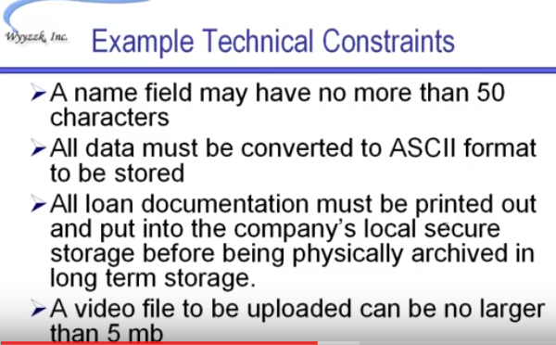

Slide 46
Glossaries
collection of definitions of both technical and business terms which can improving the communications between developers and users.
For example: Terms that stakeholders likely do not know such as XP, C#, J2EE, Application server and terms that developers may not know such as convocation, grant, and transcript etc.
Identify and documenting Change Cases
used to describe new potential requirements for a system or modifications to existing requirements
Change cases are modeled in a simple manner.
You describe the potential change to your existing requirements,
indicate the likeliness of that change occurring, and
indicate the potential impact of that change
can be identified throughout the course of your overall development and are often the result of brainstorming with your project stakeholders

Slide 47
Change case: Need to support both Linux and Microsoft platforms. Likelihood: Very likely to happen for application and database servers within six months; medium probability that Linux will be adopted by the school for desktop machines. Impact: Unknown. Currently application servers for other applications run Microsoft-based operating systems and will likely continue to do so. New servers will likely have Linux installed. Desktop impact is hard to quantify as the Linux market is evolving rapidly. Should be re-evaluated six months from now.

Slide 48
Change case: The University will open a new campus.
Likelihood: Certain. It has been announced that a new campus will be opened in two years across town.
Impact: Large. Students will be able to register in classes at either campus. Some instructors will teach at both campuses. Some departments, such as Computer Science and Philosophy, are slated to move their entire programs to the new campus. The likelihood is great that most students will want to schedule courses at only one of the two campuses, so we will need to make this easy to support.

